Slide 1

Graduation Ceremony planning and execution
Team Members
Mohammed Ashfaq- 2405952
K. Soumitri Venkatesh -24054508
R. Sudar -24047335
P.N. Yoonas -24043801
Mohammed Nishad -24047903
Mohammed Attif -24052923

Slide 2

Agenda
Introduction
Challenges for the Events
Strategic Planning to overcome challenges
Key Analysis and Progress Evaluation
Conclusion

Slide 3



INTRODUCTION
Purpose and Significance of Event
Honoring Achievements
Life Milestones

Slide 4
INTRODUCTION
Key Stakeholders and their roles
University Administration
Responsible for overall planning , resources allocation etc.
Guest of Honors
Important guests who attend the event.
Students Graduating
Key participants and contributors
Friends and Family of Students
Support and encourage students playing vital role in student engagement and event success.
Project Analyst Team
We as a team whose primary goal is to understand project along with stakeholder's expectations or needs and present the key finding and patterns to administration

Slide 5

Challenges for the Events
Common Logistical Challenges
Venue Selection
Selection of Stage and possible backups incase of weather disruptions
Seating Arrangements
Seating for guests, family, friends and students
Catering Arrangements
Refreshments and food arrangements for the students and guests
Multimedia Arrangements
All multimedia recordings, photobooths and theme-based studios for student engagements.
Aesthetic Arrangements
Decorative arrangements and themed based studio decorations sign boards and navigation boards for various places involved.

Slide 6

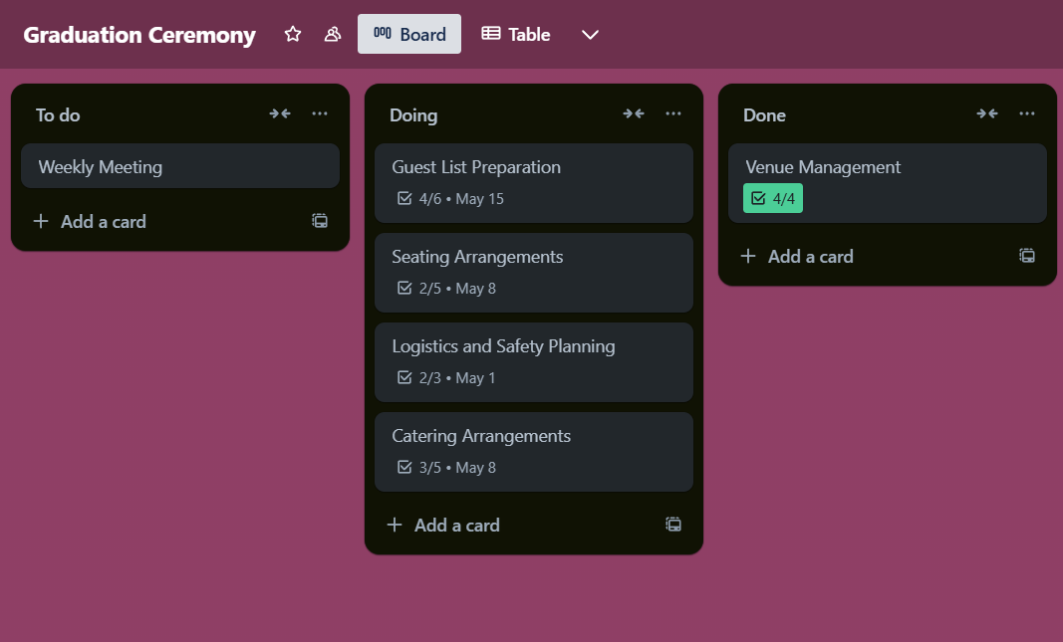
Strategic Planning to Overcome challenges
Detailed Planning and Management

Slide 7
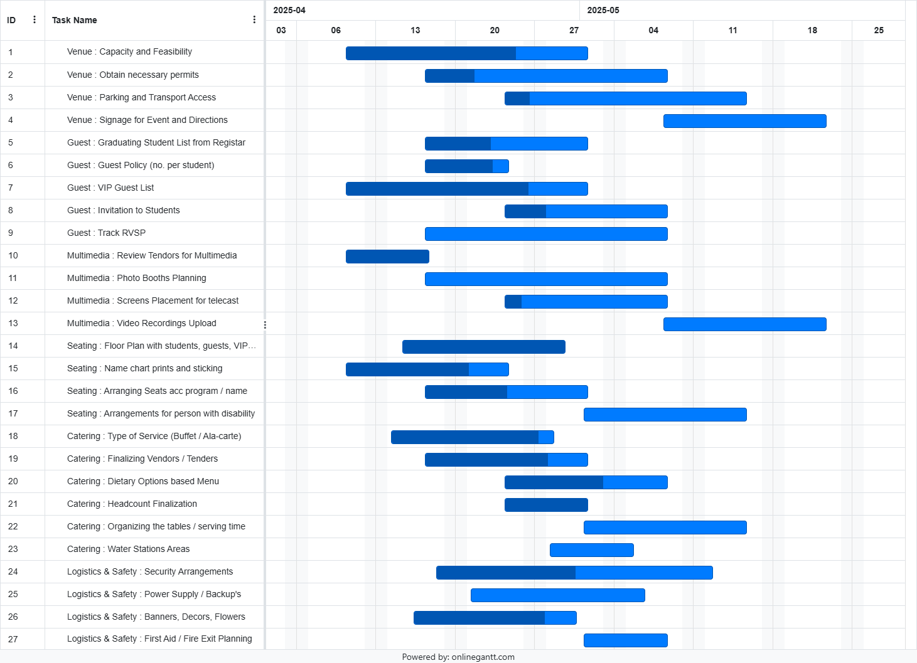

Key Analysis and Progress Evaluation

Slide 8
Key Analysis and Progress Evaluation
RSVP Status Insights
RSVP Status Pivot Table
Row Labels | Count of RSVP Status
Guest | 10005
No | 1510
Pending | 951
Yes | 7544
Grand Total | 10005

Slide 9
Key Analysis and Progress Evaluation
Dietary Preference Insights
Dietary Preference Pivot Table
Row Labels | Cnt of Dietary Preference
Guest | 10005
Gluten-Free | 1966
None | 1936
Non-Veg | 2001
Veg | 2096
Vegan | 2006
Grand Total | 10005

Slide 10
Key Analysis and Progress Evaluation
Graduates Degree and Honors Distribution

Slide 11
Key Analysis and Progress Evaluation
Honors Class RSVP Response

Slide 12

Key Take-Aways
RVSP Insights show that about 13% of the students have given maybe and including the guests that can come around to about 20% fluctuation in total attendants
Dietary Preference Insights show about 20% of the people having no preference which can give food shortages for a particular category

Slide 13
Key Take-Aways
Summa Laude Class of graduates were given extra gifts/medals for their academic achievements might need additional budget to match or give over the previous year rewards
Engage with to Summa Laude and Magma Laude Class graduates not attending to bring them as they are going to be wall of reputation

Slide 14

conclusion. Excel sheet link:https://onedrive.live.com/view.aspx?resid=C1F6A773DB6FC8C2!s83a4731aa2f2428a81944baa3186cc3b&cid=C1F6A773DB6FC8C2&CT=1745851349484&OR=ItemsView
LOOKING AHEAD

Slide 15

THANK YOU

